Slide 1
Image Optimization
By Rashaad Swanson

Slide 2
Do you need an image?
There are better ways…
Use CSS3 effects(gradients, shadows, etc.)…
Use web fonts

Slide 3
Raster vs. Vector
Raster images-each pixel with an rectangular grid
Vector images: uses lines, points, and polygons to represent image

Slide 4
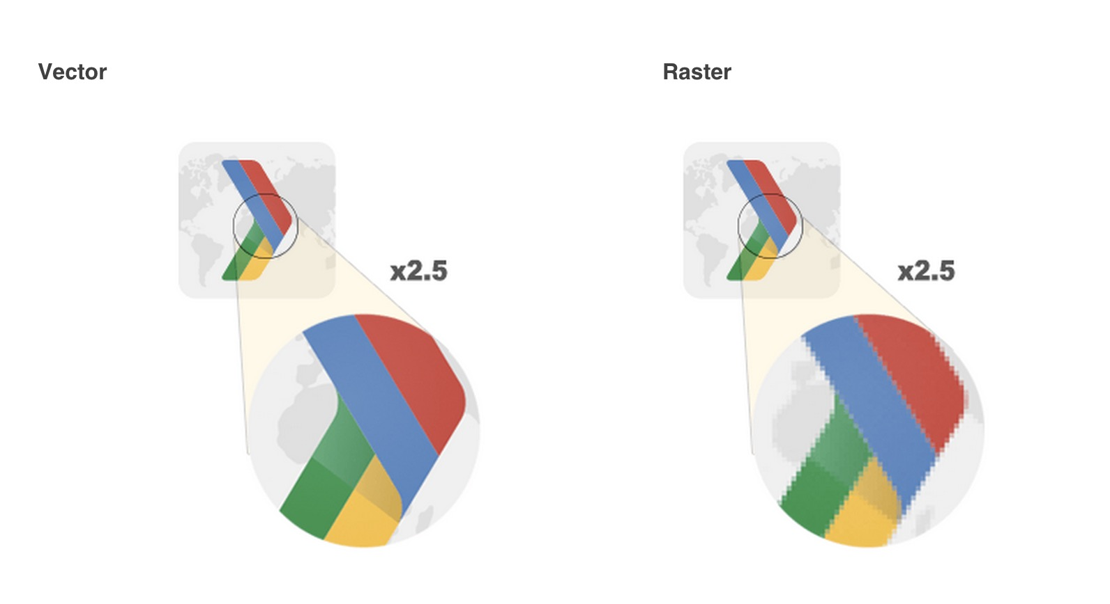
Pros and Cons
Raster image
Vector image

Slide 5
Optimizing Vector Images
Scalable Vector Images (SVG)-XML- based image format for two-dimensional graphics.
SVG files should be minimized
SVG files could be compress with GZIP

Slide 6
Optimizing Raster Images
Raster image is a grid of solid pixels
Each pixel encodes color and transparency information
What do image compressors do?

Slide 7
How to appear in Google Search Results…
https://www.youtube.com/watch?v=k442H_R5iMk

Slide 8
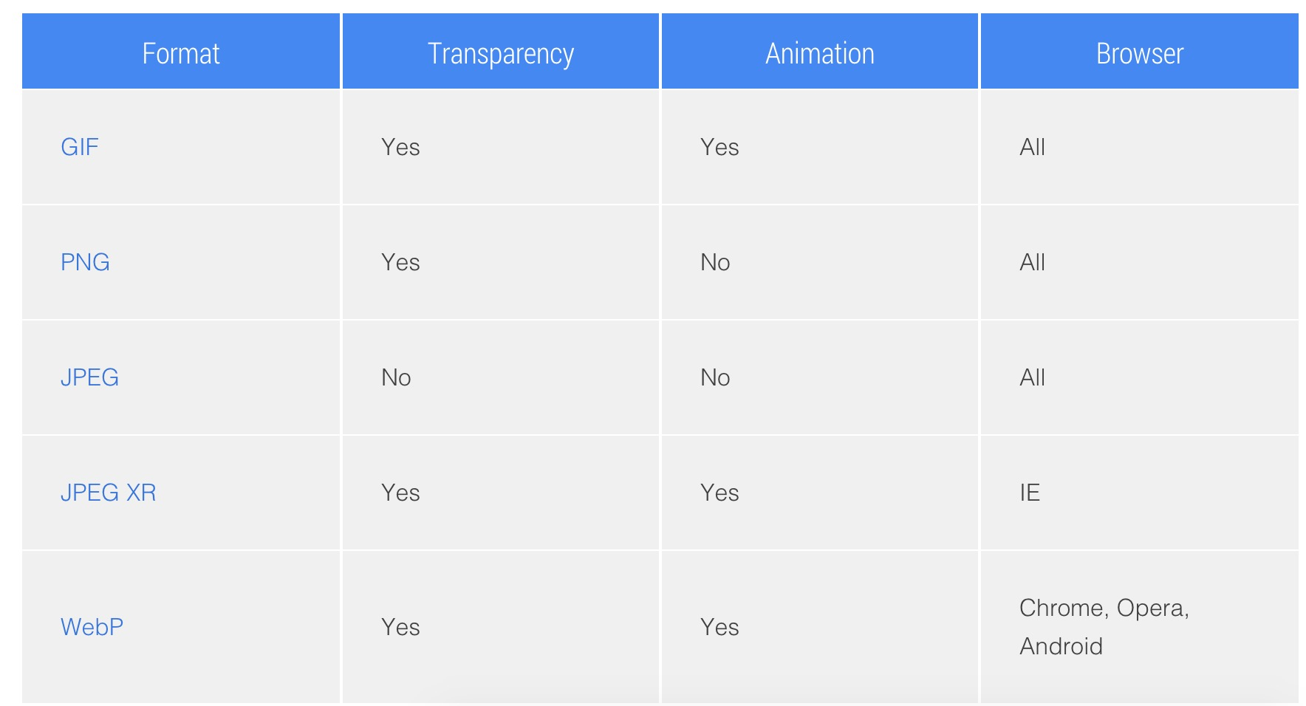
Selecting the right image format

Slide 9
Questions?
Thanks for your time and your patience but most importantly your time.

